Slide 1

Web Analytics Report: Uniqlo Online Shopping
Cameron Webb

Slide 2
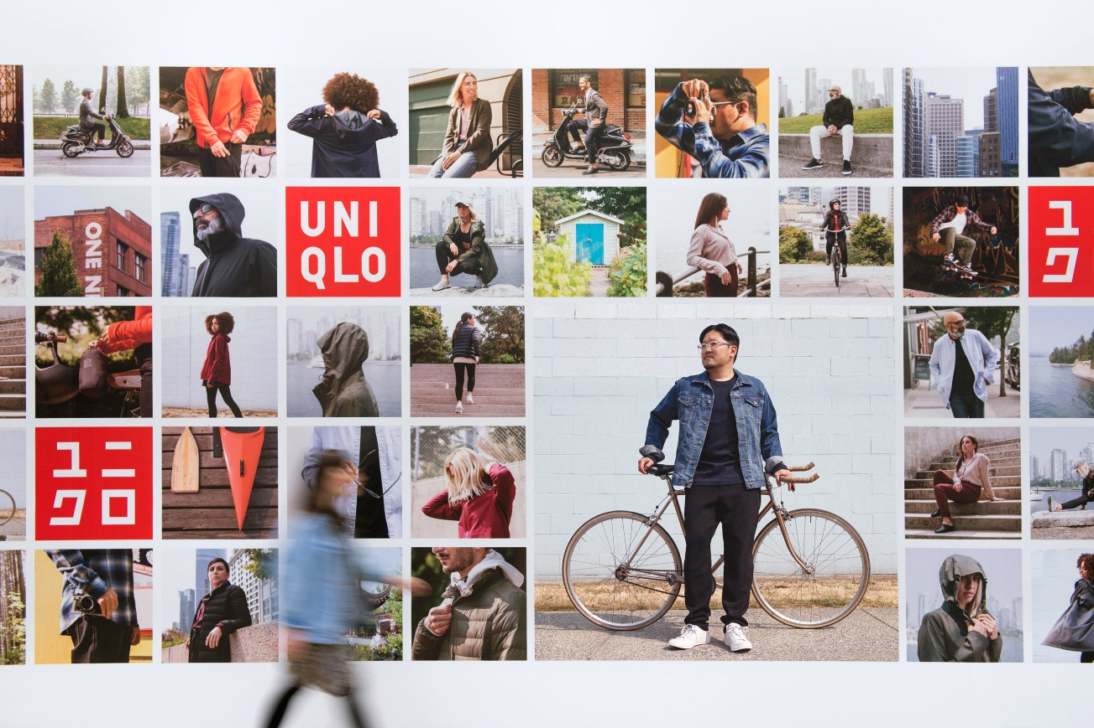

What Is Uniqlo?

Slide 3
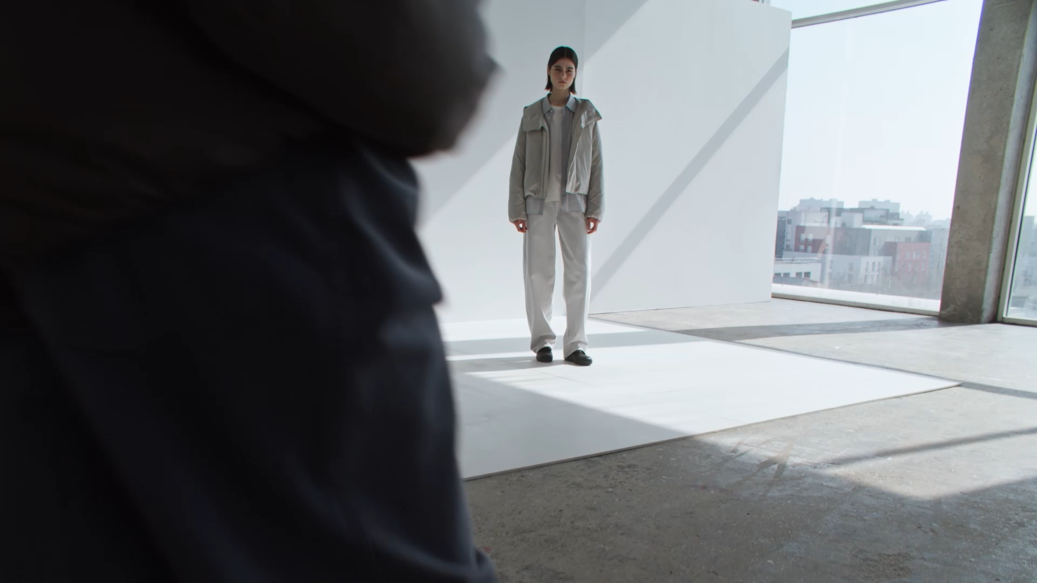
Uniqlo Is:
Global apparel retailer under Fast Retailing Co., Ltd.
Founded in Japan, (1949) started as a single menswear store
Known for their “lifewear” philosophy: simple, essential, high-quality clothing for everyday life
Specializes in affordable basics: t-shirts, jeans, outerwear, and loungewear

Slide 4
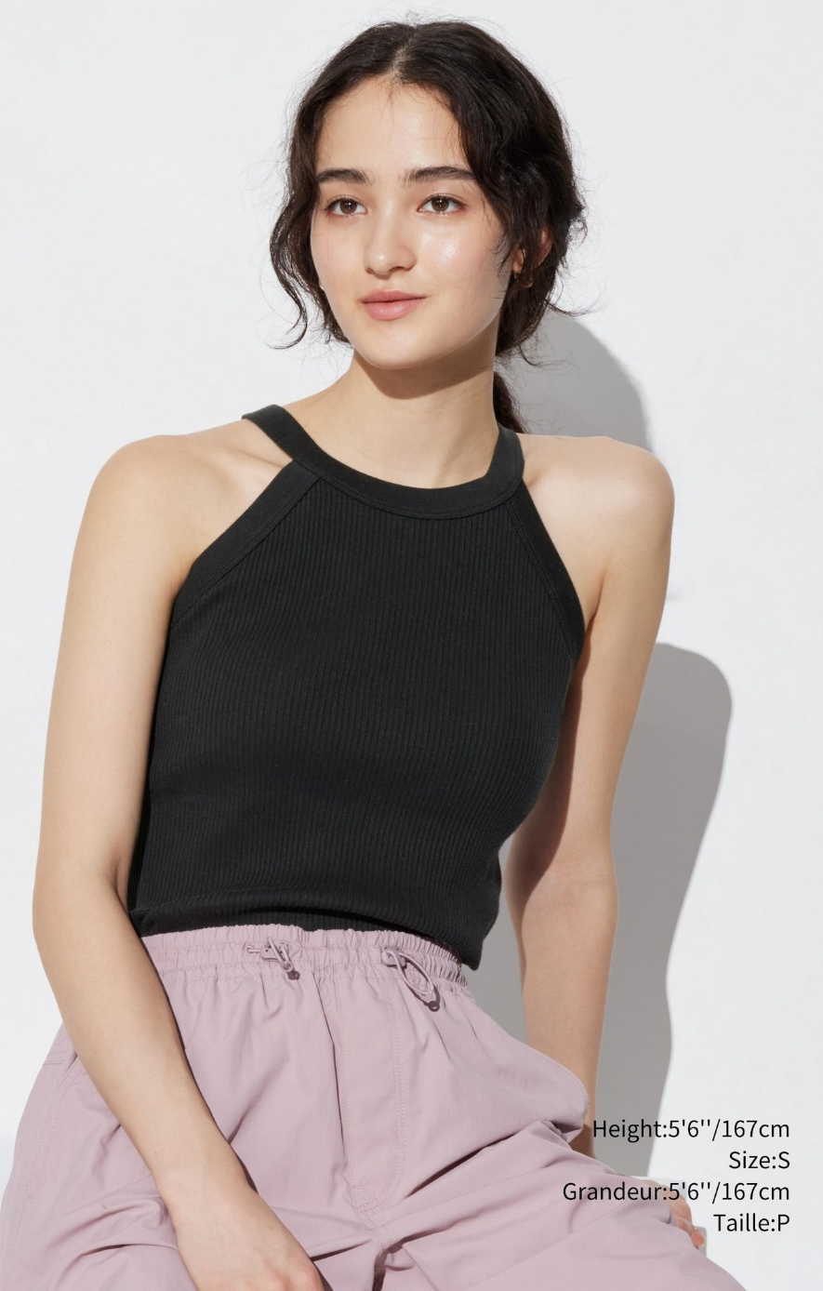
Uniqlo is (cont’d)
Uses technology-driven fabrics (e.g., Heattech, AIRism, Ultra Light Down)
Focus on minimalist, timeless design rather than fast-changing trends
Strong commitment to sustainability and recycling programs
Physical stores + global e-commerce platforms
Competes with Zara, H&M, Gap, Muji, but differentiates with function-driven basics
Appeals to 18–40-year-olds: students, young professionals, style-conscious consumers

Slide 5
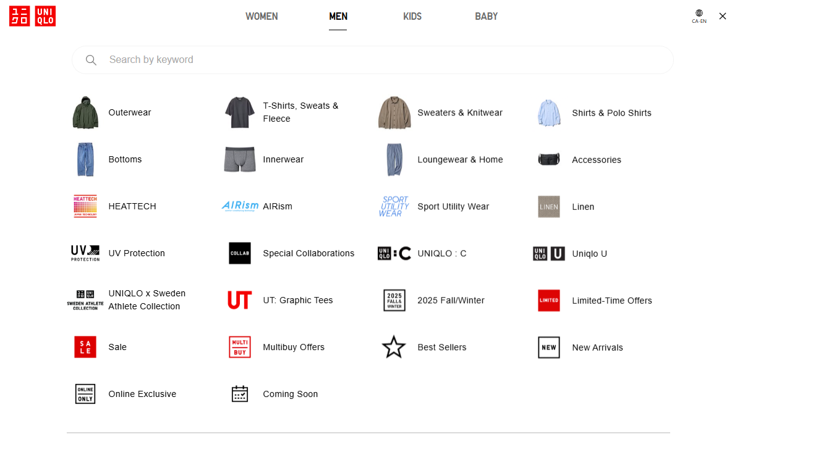
Fiscal Year | Reported Total Revenue (¥ JPY) | Approx. Total ($ CAD) | Est. Online Share 15% ($ CAD)
2023 | ¥2.33 trillion | ~$20.9B CAD | ~$3.1B CAD
2024 | ¥3.0 trillion | ~$26.9B CAD | ~$4.0B CAD
2025¬ (6 months) | ¥1.56 trillion | ~$14.0B CAD | ~$2.1B CAD

Slide 6

Objectives
Increase conversion rates & find possible website actions impeding doing so
Increase average individual order value
Assess website funnel and processes to make them more efficient
Increase brand awareness and loyalty

Slide 7

Moving on to the metrics…
Critical
The following critical metrics tell us the what of the situation in a targeted and direct manner. Meanwhile - Related supporting metrics may tell us the why and how of the situation. Those why and how conclusions can better guide next steps and tangible actions.
Supporting

Slide 8
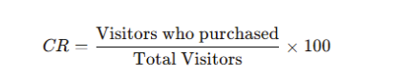
Conversion Rate (Critical Metric)
Definition: Percentage of website visitors who complete a desired action (purchase, newsletter sign-up, etc.)
Measures how effectively UNIQLO turns traffic into buyers
Benchmark against in-store performance and competitor sites
Indicates online market share potential
Action: Reduce checkout steps (guest checkout, saved payment/shipping information, etc.) to prevent drop-offs.

Slide 9
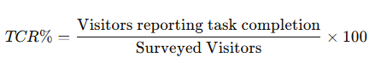
Task Completion rate (supporting metric)
Definition: % of visitors who complete their intended task (find sizing, apply coupon, locate product, purchase)
Explains why conversions succeed or fail
Identifies site features causing friction (search, filters, sizing guide)
Action: Add exit survey — capture why shoppers leave and if task was completed

Slide 10
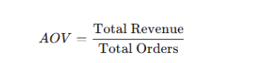
Average Order Value (Critical Metric)
Definition: Average revenue per order
Direct indicator of customer spending behavior
Comparison across time/competitors shows site & product mix performance
Higher AOV → stronger revenue without needing more traffic
Action: Promote bundle offers (buy 1 get one 50% off) or cross selling (recommend products that users frequently buy together.)

Slide 11

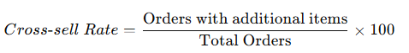
Cross-sell/Up-sell rate (Supporting Metric)
Definition: % of customers adding and buying multiple products in the same order
Pinpoints early drop-off in funnel
May reveal merchandising or usability issues
Action: Further investigate possible improvements to either the recommendation choices or the timing when the recommendation is made

Slide 12

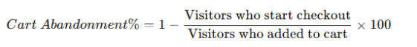
Cart Abandonment Rate (Critical Metric)
Definition: % of users who add to cart but never start checkout
Explains where conversions fail at final stage
Directly tied to lost revenue
Action: Improve the website design and make it more user-friendly resulting in a cleaner web experience.

Slide 13
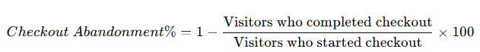
Checkout abandonment rate (Supporting Metric)
Definition: % of users who start checkout but do not finish purchase
Explains where conversions fail at final stage
Directly tied to lost revenue
Action: perform field testing or A/B experiments to see what the optimal funnel or page layout is to encourage conversions

Slide 14
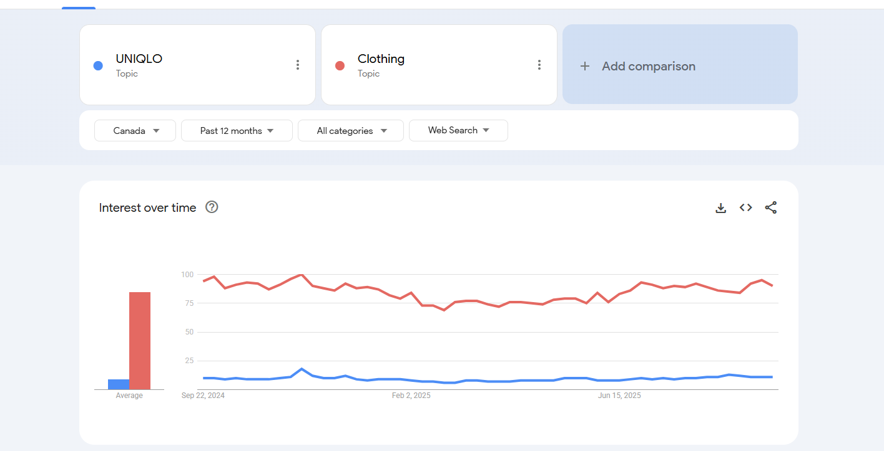
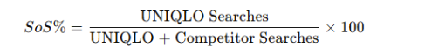
Share of Search (Critical Metric)
Example: = 494 / (494+4898) x 100% = 10.1%
Definition: % of searches for UNIQLO compared to competitor brands
Key indicator of brand visibility & interest vs rivals
Direct link to building competitive brand presence
Action: Improve search engine optimization for trending fashion keywords, invest in influencer marketing and advertising to increase search interest.

Slide 15

Visitor Loyalty (Supporting Metric)
Definition: Frequency of visits per unique visitor over time
Shows if brand awareness converts into sustained engagement
Supports Share of Search by validating long-term interest
Action: Strengthen membership program with points, offers, and notifications to encourage repeat visits.

Slide 16
OBJECTIVES ANSWERED BY METRICS
To increase conversion rates and find possible problematic areas on the website, we would look at conversion rate and task completion.
To increase average individual order value, we would assess average order value and cross sell/up-sell rate.
To assess the website's funnels and processes in an effort to make them more efficient, we would examined cart abandonment rate and checkout abandonment rate.
To increase brand presence and loyalty, we would look at share of search and visitor loyalty

Slide 17
Conclusion
By implementing the recommended actions, we can significantly enhance user experience, increase conversion rates, and drive long-term customer retention.
Streamlining the checkout process and incorporating exit surveys will help reduce drop-offs and gather critical feedback.
Strategic promotional tactics such as bundle offers and personalized recommendations can boost average order value and user engagement.
Improving the website's design and functionality will create a clearer and more intuitive customer experience, while A/B testing will ensure data-driven optimization occurs for maximum value.
Leveraging search engine optimization, influencer marketing and targeted advertising will increase customer reach and drive in new user traffic.
Lastly focusing more on the membership program and rewards with personalized offers will encourage repeat visits and foster higher brand loyalty.

Slide 18

FIN

